Slide 1


Slide 2
Dynamic Programming
Invented by American mathematician Richard Bellman in the 1950s’ to solve optimization problems
Dynamic Programming is an algorithmic paradigm that solves a given complex problem by breaking it into subproblems and stores the results of subproblems to avoid computing the same results again.
Following are the two main properties of a problem that suggest that the given problem can be solved using Dynamic programming.
1) Overlapping Subproblems
2) Optimal Substructure

Slide 3
1) Overlapping Subproblems:
Like Divide and Conquer, Dynamic Programming combines solutions to sub-problems.
Dynamic Programming is mainly used when solutions of same subproblems are needed again and again.
In dynamic programming, computed solutions to subproblems are stored in a table so that these don’t have to recomputed.
So Dynamic Programming is not useful when there are no common (overlapping) subproblems because there is no point storing the solutions if they are not needed again.
For example If we take example of following recursive program for Fibonacci Numbers, there are many subproblems which are solved again and again.

Slide 4
Recursion tree for execution of fib(5)
fib(5)
/ \
fib(4) fib(3)
/ \ / \
fib(3) fib(2) fib(2) fib(1)
/ \ / \ / \
fib(2) fib(1) fib(1) fib(0) fib(1) fib(0)
/ \
fib(1) fib(0)
We can see that the function f(3) is being called 2 times. If we would have stored the value of f(3), then instead of computing it again, we could have reused the old stored value

Slide 5
There are following two different ways to store the values so that these values can be reused:
a) Memoization (Top Down)
The memoized program for a problem is similar to the recursive version with a small modification that it looks into a lookup table before computing solutions.
We initialize a lookup array with all initial values as NIL. Whenever we need solution to a subproblem, we first look into the lookup table.
If the precomputed value is there then we return that value, otherwise we calculate the value and put the result in lookup table so that it can be reused later.
b) Tabulation (Bottom Up)
The tabulated program for a given problem builds a table in bottom up fashion and returns the last entry from table.
For example, for the same Fibonacci number, we first calculate fib(0) then fib(1) then fib(2) then fib(3) and so on.
So literally, we are building the solutions of subproblems bottom-up.

Slide 6
Both Tabulated and Memoized store the solutions of subproblems.
In Memoized version, table is filled on demand while in Tabulated version, starting from the first entry, all entries are filled one by one.
Unlike the Tabulated version, all entries of the lookup table are not necessarily filled in Memoized version.
Time taken by Recursion method is much more than the two Dynamic Programming techniques mentioned above – Memoization and Tabulation!

Slide 7
2) Optimal Substructure
A given problems has Optimal Substructure Property if optimal solution of the given problem can be obtained by using optimal solutions of its subproblems.
the solutions to the subproblems used within the optimal solution must themselves be optimal (optimality principle).
The dynamic programming relies on a principle of optimality. This principle states that in an optimal sequence of decisions or choices, each subsequence must also be optimal.

Slide 8
Examples of DP algorithms
Computing a binomial coefficient.
Knapsack problem
Matrix-Chain Multiplication
Making change problem
Assembly line sheduling

Slide 9
Computing a binomial coefficient.
Here is the expansion of (x + y)^{n} for n = 0, 1,…, 5 :
(x + y)⁰ = 1
(x + y)¹ = x + y
(x + y)² = x ² +2xy + y ²
(x + y)³ = x ³ +3x ² y + 3xy ² + y ³
(x + y)⁴ = x ⁴ +4x ³ y + 6x ² y ² +4xy ³ + y ⁴
(x + y)⁵ = x ⁵ +5x ⁴ y + 10x ³ y ² +10x ² y ³ +5xy ⁴ + y ⁵
  Binomial coefficients are coefficients of the binomial formula:
  (a + b)^{n} = C(n,0)a^{n}b⁰ + . . . + C(n,k)a^{n-k}b^{k} + . . . + C(n,n)a⁰b^{n}
  Properties : C(n,k) = C(n-1,k) + C(n-1,k-1) for n > k > 0
  C(n,0) = 1, C(n,n) = 1 for n ≥ 0

Slide 10
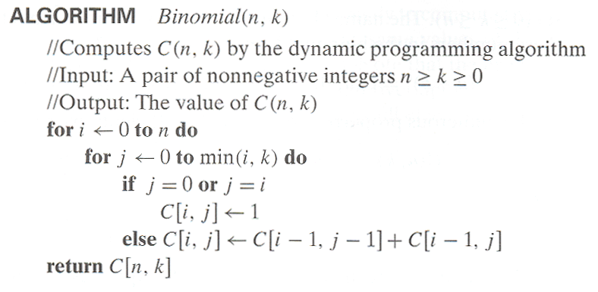
Computing C(n,k): pseudocode

Slide 11
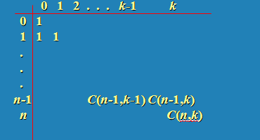
  Value of C(n,k) can be computed by filling a table:

Slide 12
Knapsack problem
There are two versions of the problem:
“0-1 knapsack problem”
  Items are indivisible; you either take an item or not. Solved with dynamic programming.
“Fractional knapsack problem”
  Items are divisible: you can take any fraction of an item. Solved with a greedy algorithm.

Slide 13
Knapsack Problem by DP
Given n items of
  integer weights: w₁ w₂ … w_{n}
  values: v₁ v₂ … v_{n}
a knapsack of integer capacity W
find most valuable subset of the items that fit into the knapsack
Consider instance defined by first i items and capacity j (j ≤ W).
Let V[i,j] be optimal value of such instance. Then
max {V[i-1,j], v_{i} + V[i-1,j- w_{i}]} if j- w_{i} ≥ 0
V[i,j] =
V[i-1,j] if j- w_{i} < 0
Initial conditions: V[0,j] = 0 and V[i,0] = 0

Slide 14
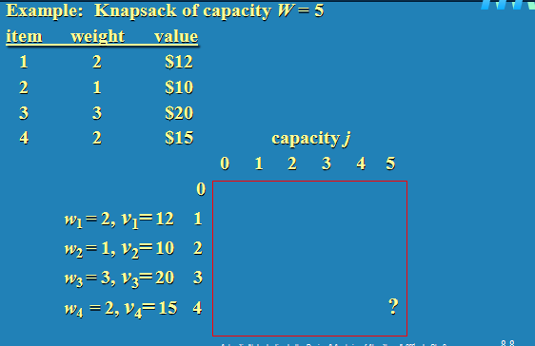
Knapsack problem

Slide 15
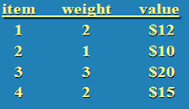
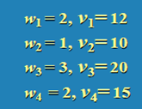
Example
i
0
1
2
3
4
5
0
0
1
0
2
0
3
0
4
0

Slide 16
Example
i
0
1
2
3
4
5
0
0
0
0
0
0
0
1
0
2
0
3
0
4
0

Slide 17
Matrix-Chain Multiplication
Problem: given a sequence ⟨A₁, A₂, …, A_{n}⟩, compute the product:
A₁ ⋅ A₂ ⋅⋅⋅ A_{n}
Matrix compatibility:
C = A ⋅ B

Slide 18
MATRIX-MULTIPLY(A, B)
if columns[A] ≠ rows[B]
then error “incompatible dimensions”
else for i ← 1 to rows[A]
do for j ← 1 to columns[B]
do C[i, j] = 0
for k ← 1 to columns[A]
do C[i, j] ← C[i, j] + A[i, k] B[k, j]

Slide 19
Matrix-Chain Multiplication
In what order should we multiply the matrices?
A₁ ⋅ A₂ ⋅⋅⋅ A_{n}
Parenthesize the product to get the order in which matrices are multiplied
E.g.: A₁ ⋅ A₂ ⋅ A₃ = ((A₁ ⋅ A₂) ⋅ A₃)
= (A₁ ⋅ (A₂ ⋅ A₃))
Which one of these orderings should we choose?
  The order in which we multiply the matrices has a significant impact on the cost of evaluating the product

Slide 20
Example
A₁ ⋅ A₂ ⋅ A₃
A₁: 10 x 100
A₂: 100 x 5
A₃: 5 x 50
1. ((A₁ ⋅ A₂) ⋅ A₃): A₁ ⋅ A₂ = 10 x 100 x 5 = 5,000 (10 x 5)
((A₁ ⋅ A₂) ⋅ A₃) = 10 x 5 x 50 = 2,500
Total: 7,500 scalar multiplications
2. (A₁ ⋅ (A₂ ⋅ A₃)): A₂ ⋅ A₃ = 100 x 5 x 50 = 25,000 (100 x 50)
(A₁ ⋅ (A₂ ⋅ A₃)) = 10 x 100 x 50 = 50,000
Total: 75,000 scalar multiplications
one order of magnitude difference!!

Slide 21
Matrix-Chain Multiplication:
Problem Statement
Given a chain of matrices ⟨A₁, A₂, …, A_{n}⟩, where A_{i} has dimensions p_{i-1}x p_{i}, fully parenthesize the product A₁ ⋅ A₂ ⋅⋅⋅ A_{n} in a way that minimizes the number of scalar multiplications.
A₁ ⋅ A₂ ⋅⋅⋅ A_{i} ⋅ A_{i+1} ⋅⋅⋅ A_{n}
p₀ x p₁ p₁ x p₂ p_{i-1} x p_{i} p_{i} x p_{i+1} p_{n-1} x p_{n}

Slide 22
Computing the Optimal Costs
0 if i = j
m[i, j] = min {m[i, k] + m[k+1, j] + p_{i-1}p_{k}p_{j}} if i < j
^{i≤k<j}
Length = 1: i = j, i = 1, 2, …, n
Length = 2: j = i + 1, i = 1, 2, …, n-1
1
2
3
n
n
m[1, n] gives the optimal
solution to the problem
Compute rows from bottom to top and from left to right
3
2
1

Slide 23
Example: min {m[i, k] + m[k+1, j] + p_{i-1}p_{k}p_{j}}
m[2, 2] + m[3, 5] + p₁p₂p₅
m[2, 3] + m[4, 5] + p₁p₃p₅
m[2, 4] + m[5, 5] + p₁p₄p₅
k = 2
m[2, 5] = min
k = 3
k = 4
1
2
3
4
5
6
6
5
Values m[i, j] depend only on values that have been previously computed
4
j
3
2
1
i

Slide 24
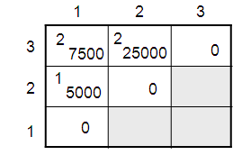
Example min {m[i, k] + m[k+1, j] + p_{i-1}p_{k}p_{j}}
Compute A₁ ⋅ A₂ ⋅ A₃
A₁: 10 x 100 (p₀ x p₁)
A₂: 100 x 5 (p₁ x p₂)
A₃: 5 x 50 (p₂ x p₃)
m[i, i] = 0 for i = 1, 2, 3
m[1, 2] = m[1, 1] + m[2, 2] + p₀p₁p₂ (A₁A₂)
= 0 + 0 + 10 *100* 5 = 5,000
m[2, 3] = m[2, 2] + m[3, 3] + p₁p₂p₃ (A₂A₃)
= 0 + 0 + 100 * 5 * 50 = 25,000
m[1, 3] = min m[1, 1] + m[2, 3] + p₀p₁p₃ = 75,000 (A₁(A₂A₃))
m[1, 2] + m[3, 3] + p₀p₂p₃ = 7,500 ((A₁A₂)A₃)

Slide 25
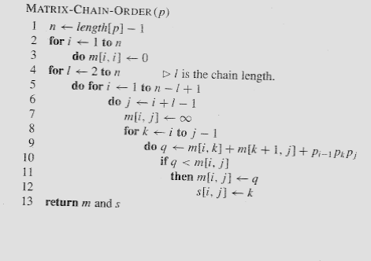
Matrix-Chain-Order(p)

Slide 26



Slide 28


